Slide 1



Design and Analysis of a Bi-directional Transformable Wheel Robot Trimode
2021 IEEE/RSJ International Conference on Intelligent Robotics and Systems
Qiwei Xu, Hao Xu, Kun Xiong, Qinqin Zhou and Weizhong Guo*
Shanghai Jiao Tong University and Tencent RoboticsX
Notes:
Hello everyone, I am Xu Hao, from Shanghai Jiao Tong University, China. I am here to present our IROS paper “Design and Analysis of a Bi-directional Transformable Wheel Robot Trimode”.

Slide 2

01
INTRODUCTION
CONTENTS
02
CONCEPT OF THE TRANSFORMABLE WHEEL
03
DESIGN OF THE ROBOT PLATFORM
04
EXPERIMENT
05
CONCLUSIONS
Notes:
I will introduce Trimode in the following five parts.

Slide 3
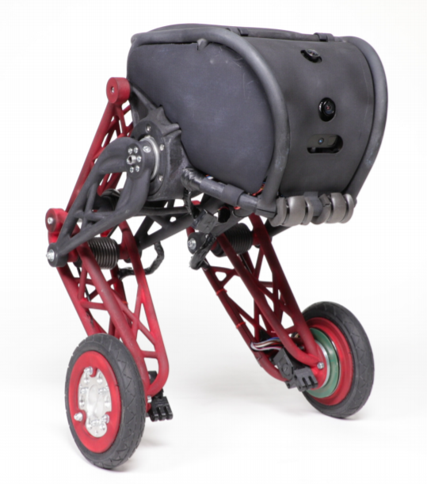
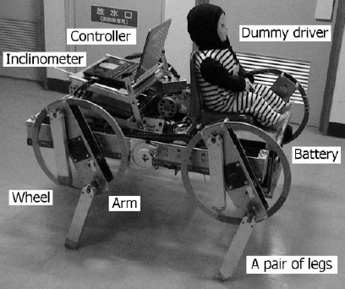
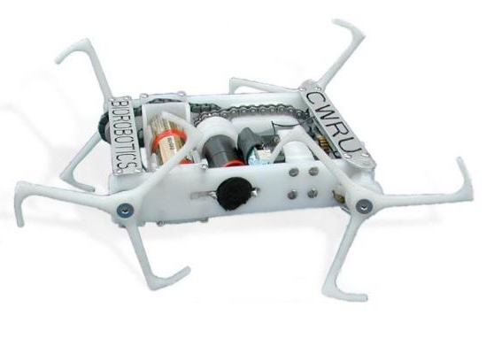
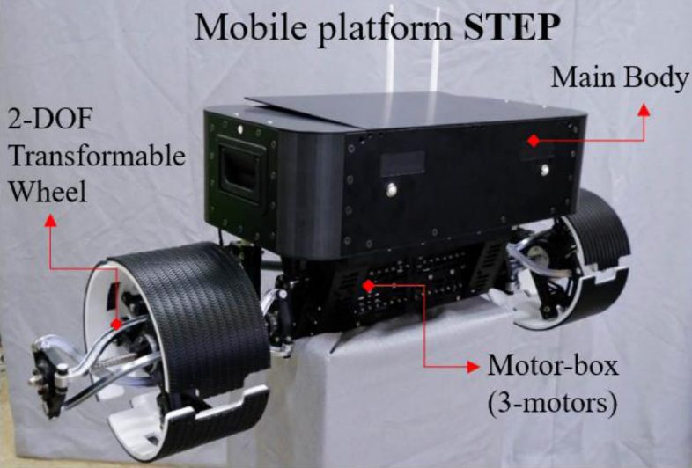
Four types of hybrid wheel-leg robots
Introduction
The appendage of legs on the circumference of wheels
Wheels attached on the bottom of the legs
Wheels and legs attached on the platform separately
Wheels transform from circular wheel to legged wheel
Whegs [3]-[6]
CALMOS [11]
PEOPLER-II [12]
STEP [16]
Notes:
In order to better adapt to uneven terrain, several kinds of hybrid wheel-leg robots have been proposed. And they can be categorized into four types with different mechanisms.
(click) The fourth kind of robot is called transformable wheeled robot, which can transform its morphology from circular wheel into legged wheel.

Slide 4
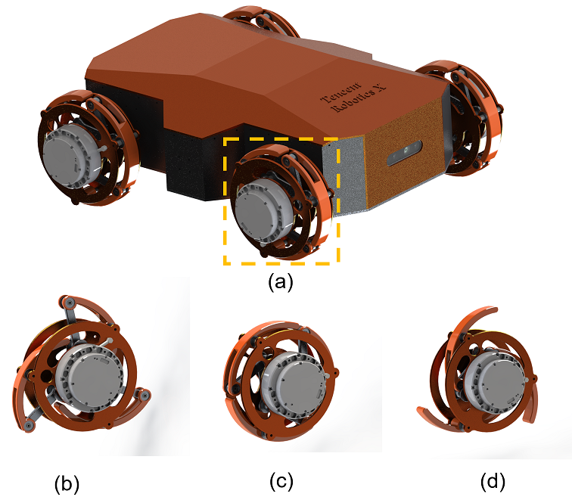
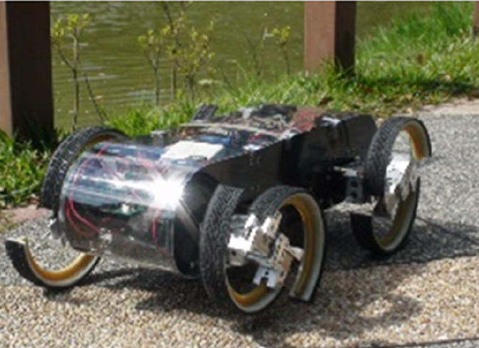
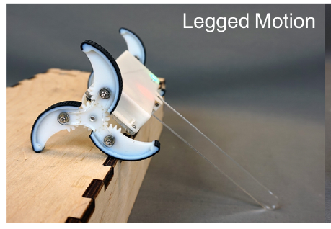
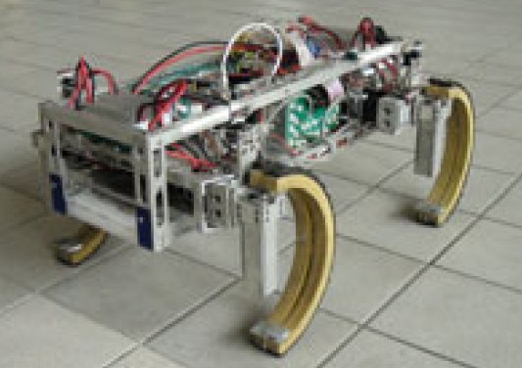
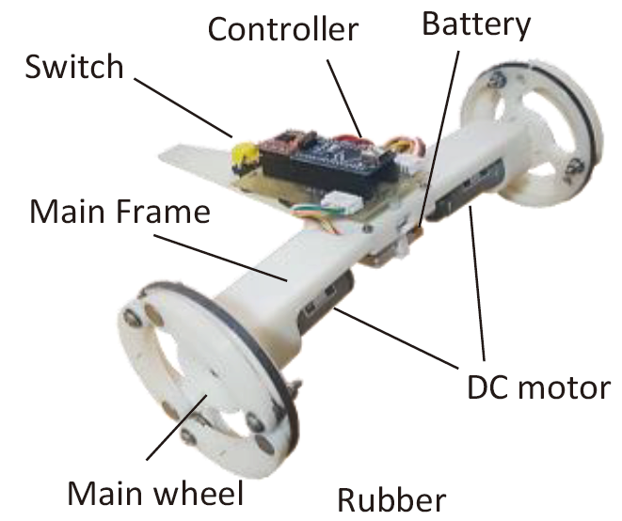
Our design – from unidirectional to bi-directional transformable
Introduction
Unidirectional
Bi-directional
Notes:
However, most transformable wheeled robots have only one wheel-leg mode, therefore these robots can overcome obstacles unidirectionally. That means they should turn around one hundred and eighty degrees to come down the obstacle in avoidance of falling off from it.
(click) We propose a novel transformable wheel-leg robot called Trimode, which can transform its morphology among the circular wheel and two different legged wheel modes with just one driver for transformation.

Slide 5
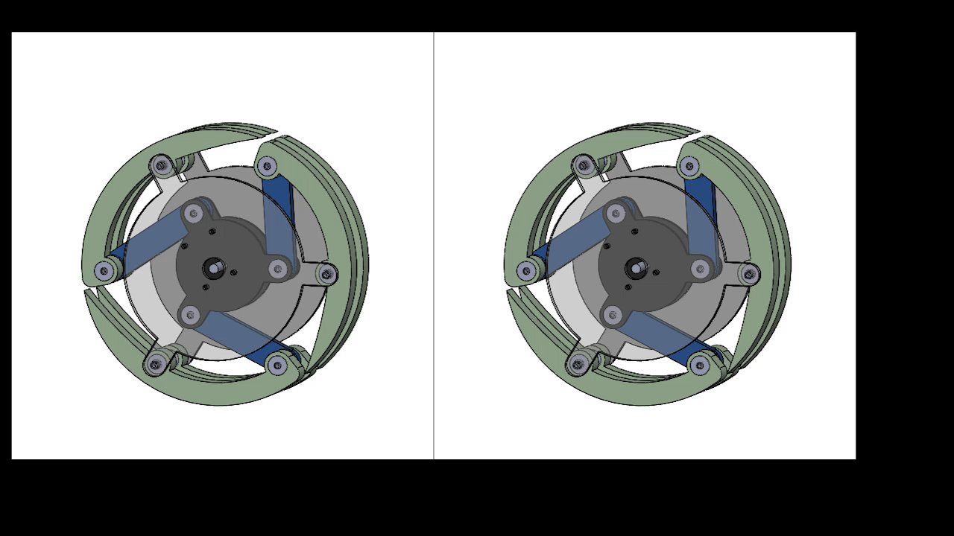
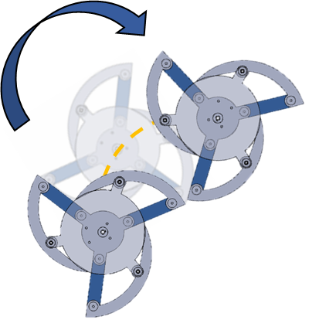
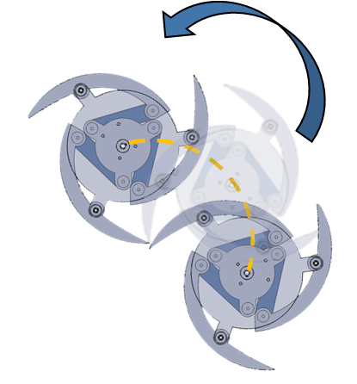
Concept of the transformable wheel mechanism
Mechanism Design of the Transformable Wheel
Transformable wheel based on four-bar mechanism
Backward
Forward
CCW
Transformation
CW
Transformation
Notes:
The key to our design is the transformable wheel. Its mechanism is based on a four-bar mechanism.
(click) The clockwise rotation of the active bar makes the circular wheel transformed into CW legged wheel and the counter-clockwise rotation of the bar makes the wheel transformed into CCW legged wheel. So the wheel can transform into two modes based on only one driver.
(click) These claw-like legs help the wheel hook the upper side of the obstacle when the wheel rotates, therefore, both legged wheels have good obstacle-overcoming performance in forward and backward directions.

Slide 6
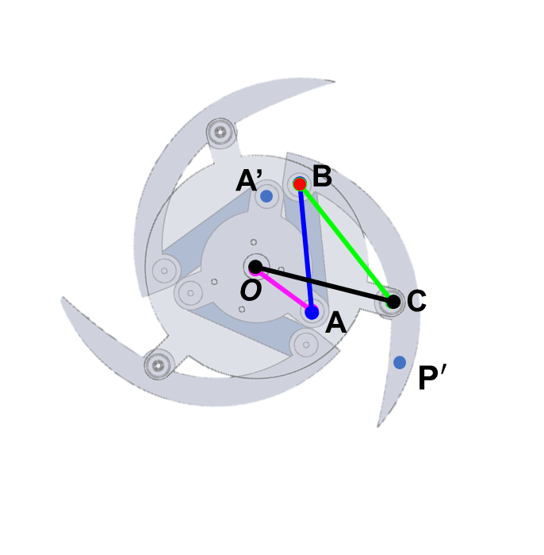
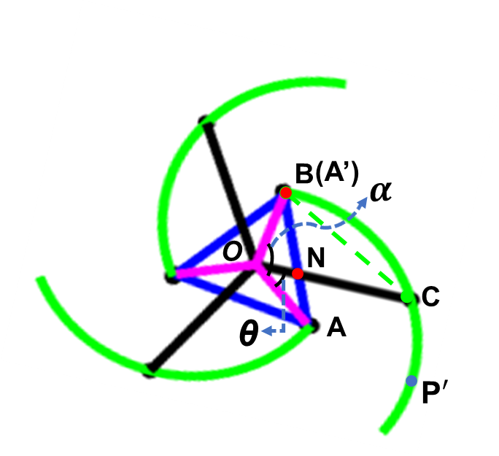


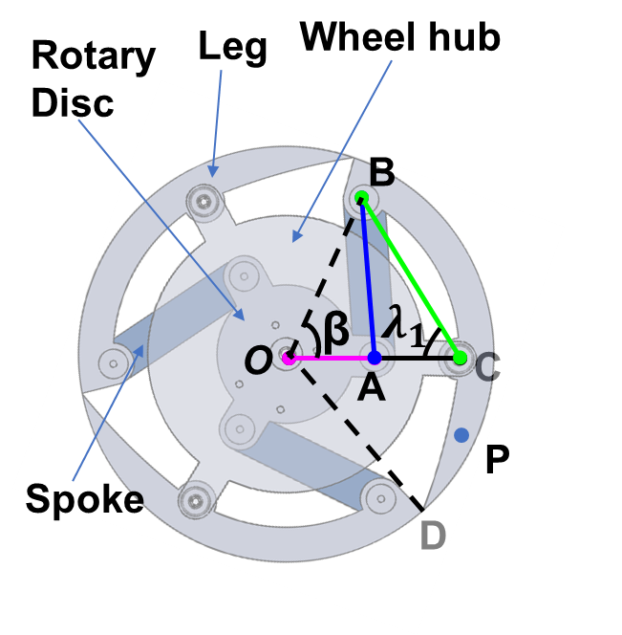

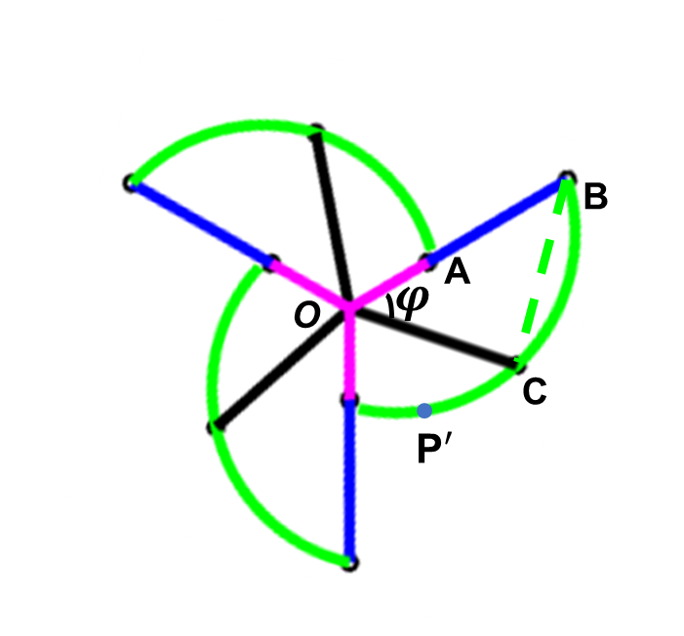

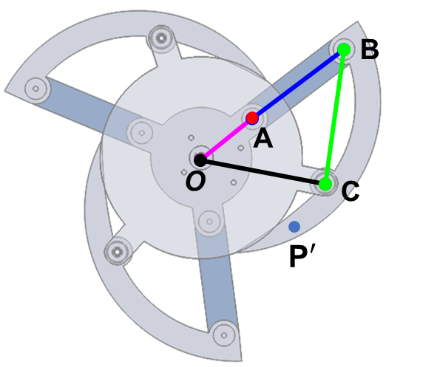
Concept of the transformable wheel mechanism
Mechanism Design of the Transformable Wheel
CW
CCW
Notes:
(click) Here we present two limit cases of CW and CCW legged wheel modes, and build mathematical models of the two modes.
(click) We employ interference between the bars and the dead center of the four-bar mechanism to reduce the load of the transformation motors to maintain legged wheel mode.

Slide 7
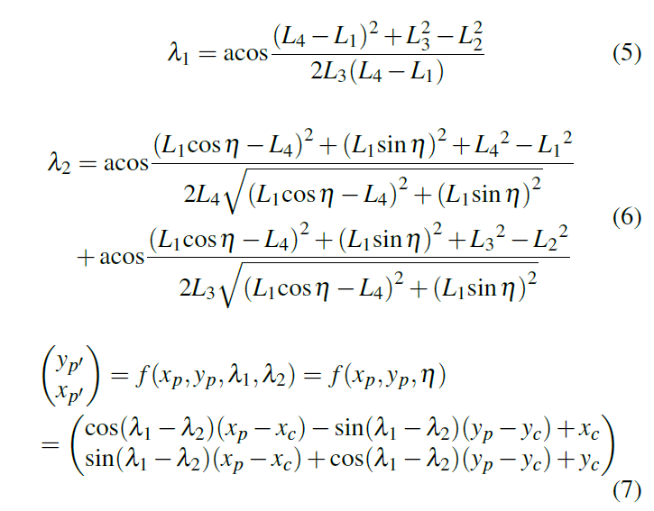
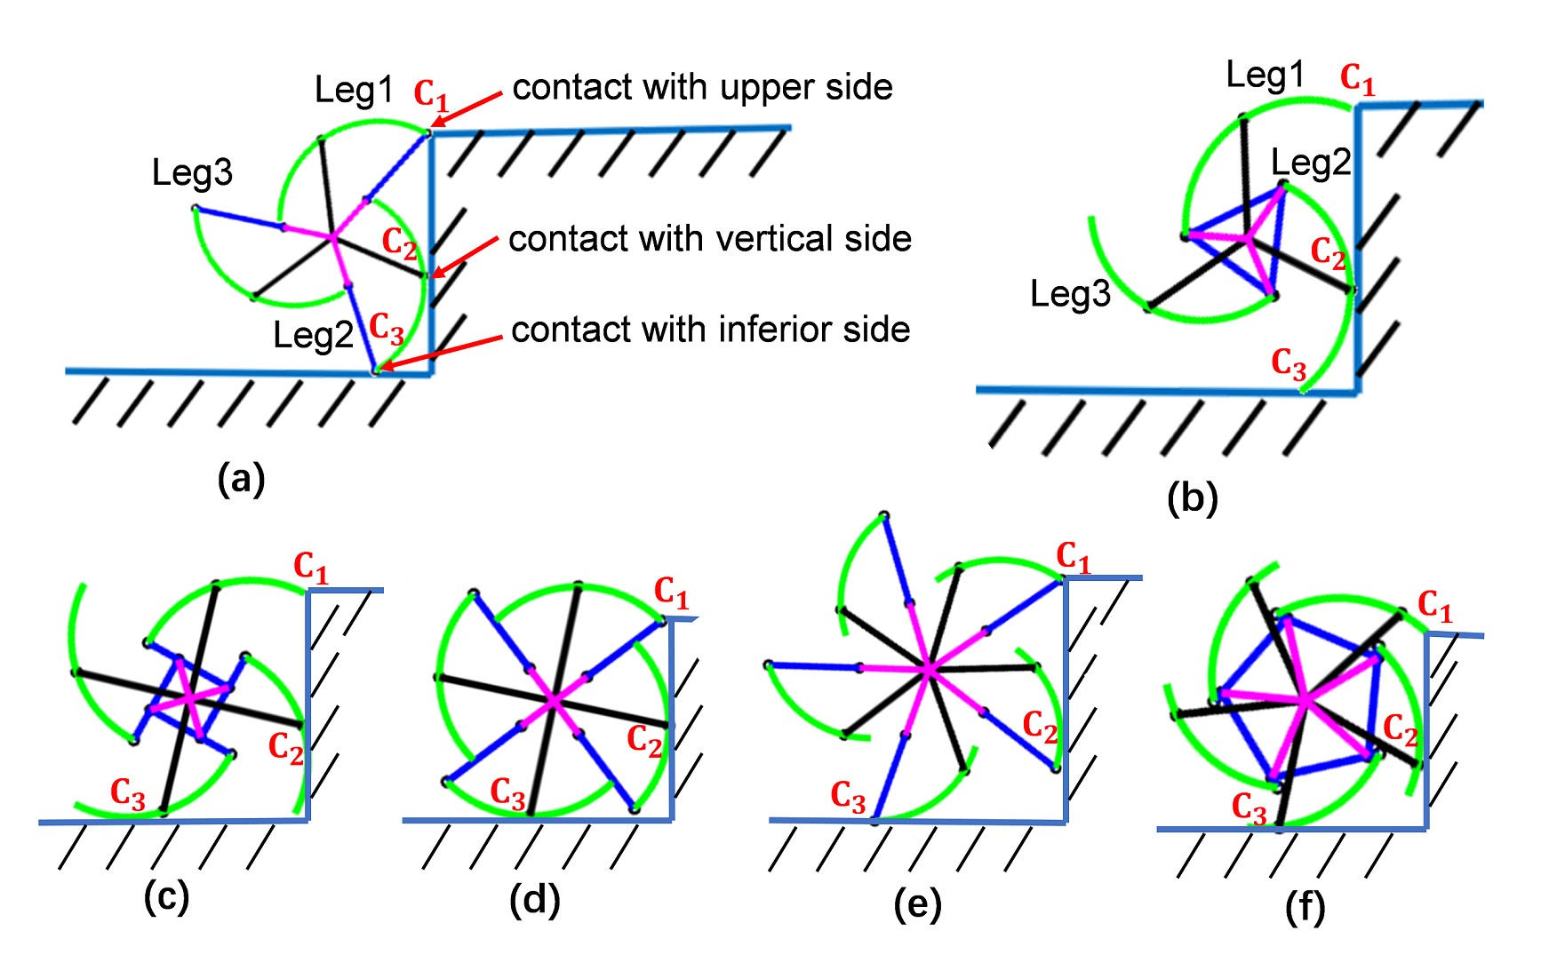
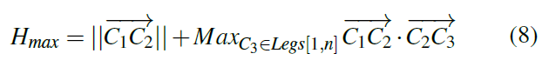
Mathematical expression of the wheel’s shape and evaluation of obstacle-climbing ability
Mechanism Design of the Transformable Wheel
Notes:
In order to determine the maximum height of the step that both legged wheels can overcome, we analyze limit cases that wheels with different numbers of legs can overcome. According to the mathematical model, we finally get the maximum height as Equation 8.

Slide 8
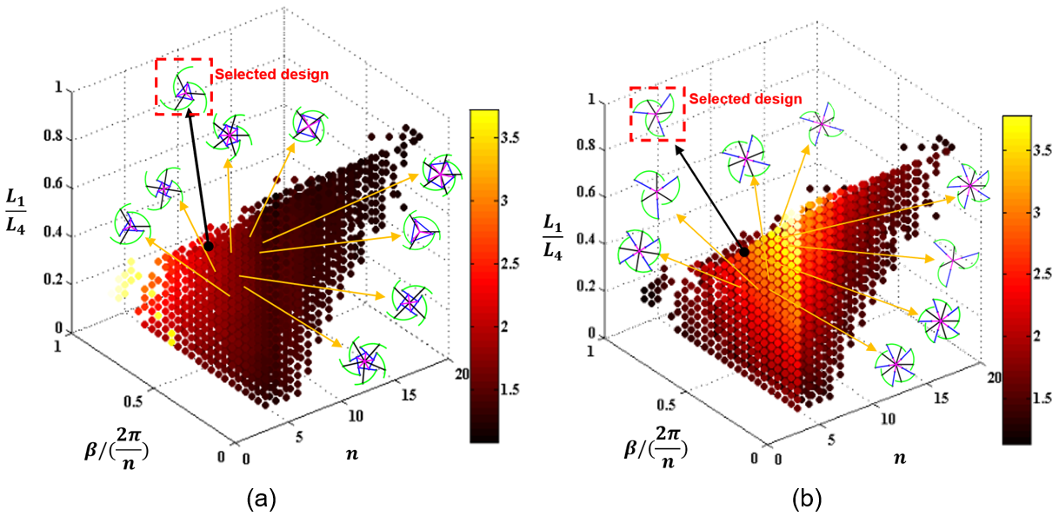


Mathematical expression of the wheel’s shape and evaluation of obstacle-climbing ability
Mechanism Design of the Transformable Wheel
Optimal goal: $H_{max}/L_{4}$
Design variables:
$n$: the number of legs of the wheel
$β/(2π/n)$: the ratio of the central angle of $\hat{\text{BC}}$ to the central angle of a single leg
$L_{1}/L_{4}$: the ratio of the length of OA to the wheel radius
Design parameters:$\left(n,\frac{β}{2π/n}, \frac{L_{1}}{L_{4}}\right)=(3,0.46,0.51)$
Optimal goal:$\frac{H_{max}}{L_{4}}=2.26/2.41$ (CW&CCW)
Notes:
So far, this design problem is transformed into an optimal problem. We simplify the design variables into three variables, as shown in the slide. Our goal and design variables are all dimensionless quantities, so they are not affected by dimension.
(click) From the result, we can see the increase of n results in the decrease of the obstacle-overcoming ability in both legged wheel modes. So the number of legs in one wheel is chosen as 3. But the impact of the other two variables on the goal is not monotonical. Therefore, we make a trade-off and choose the three design variables like this. (click)
Theoretical results show both the CW and the CCW legged wheel modes can climb the step of more than two times radii.

Slide 9
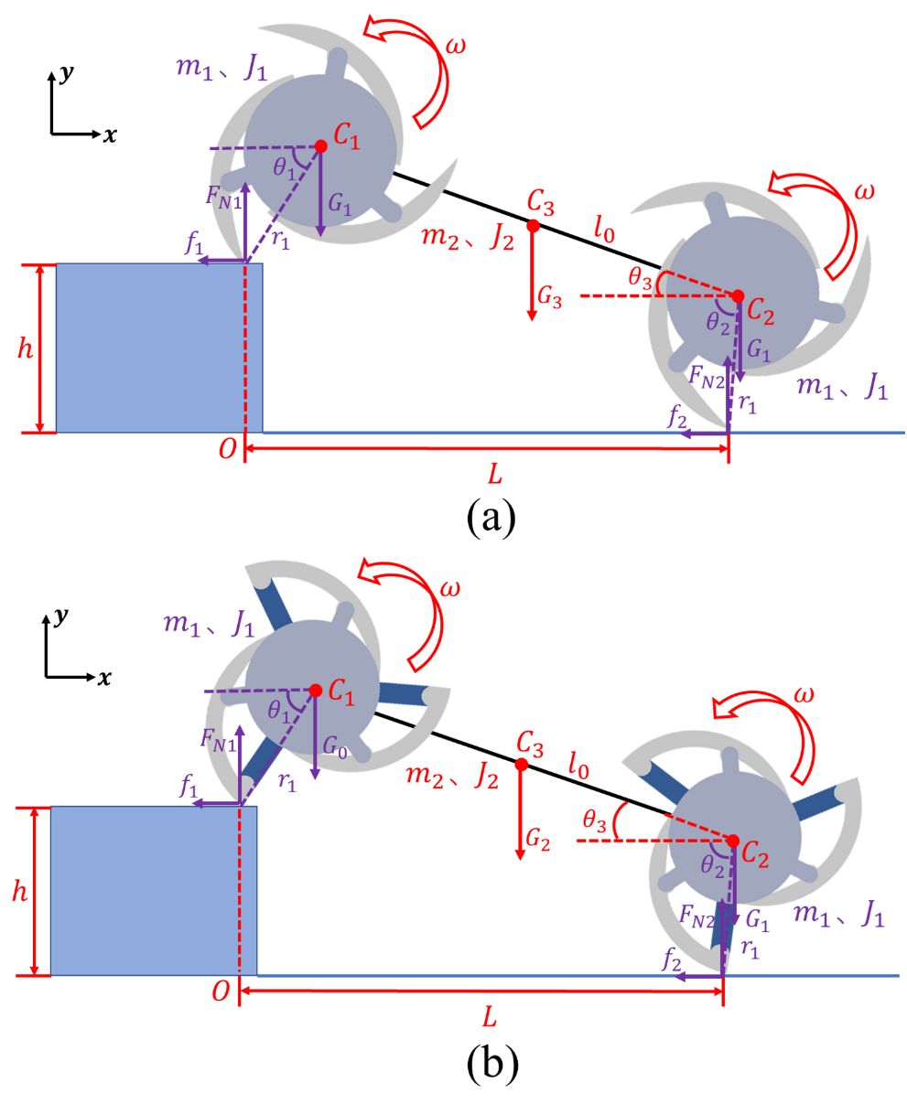
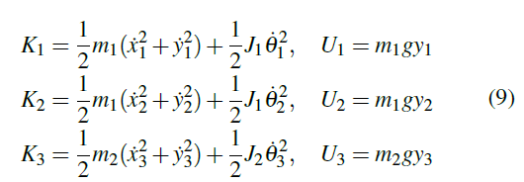
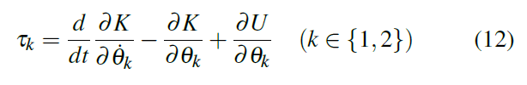
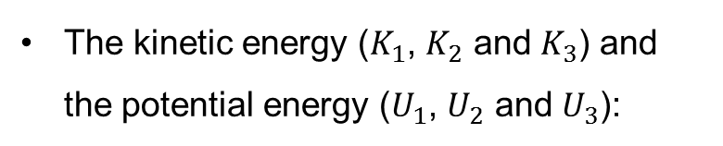
Dynamics analysis of the robot platform
Design of the Transformable Wheeled Robot Platform
The kinetic energy ($K_{1}$, $K_{2}$ and $K_{3}$) and the potential energy ($U_{1}$, $U_{2}$ and $U_{3}$):
Torque of driving motors from Lagrange Equation:
Notes:
Here we establish dynamic models of the robot platform, and analyze the effect of platform design variables on the torque load of the wheels. We make the length of the wheelbase and angular velocity as two design variables. Then we choose the scene where the robot is climbing steps and derive Newton-Euler Equation and Lagrange Equation.

Slide 10
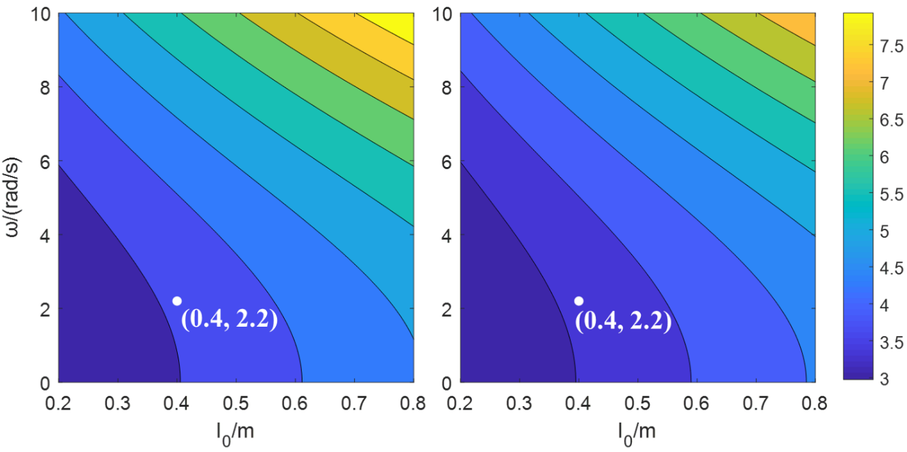
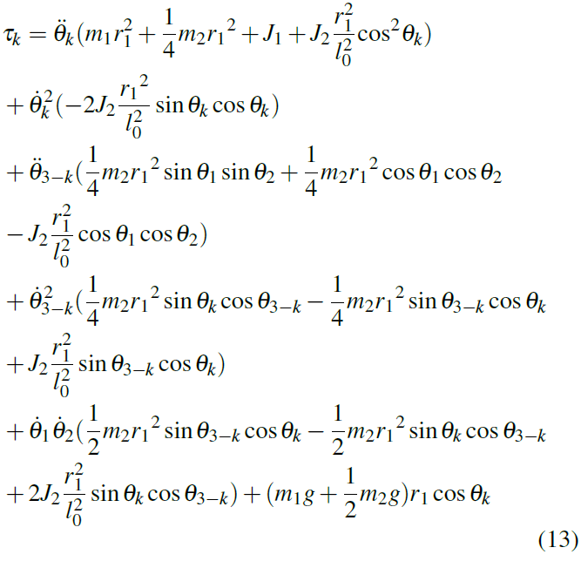

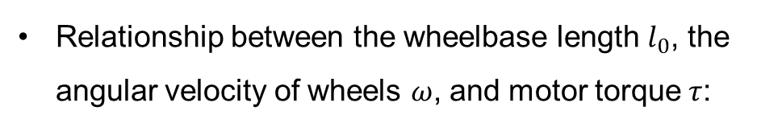
Dynamics analysis of the robot platform
Design of the Transformable Wheeled Robot Platform
Torque of driving motors from Lagrange Equation:
Relationship between the wheelbase length $l_{0}$, the angular velocity of wheels $ω$, and motor torque $τ$:
Parameters after trade-off:
$$\left(l_{0}, ω\right)=(0.4, 2.2)$$
Notes:
As a result, the torque of the motors t1 and t2 can be determined by the two variables as well as other known parameters. Finally, regarding the contour division of the simulation results, we choose the length of the wheelbase and the angular velocity as shown in the slide as the selected design parameters of the robot platform.

Slide 11
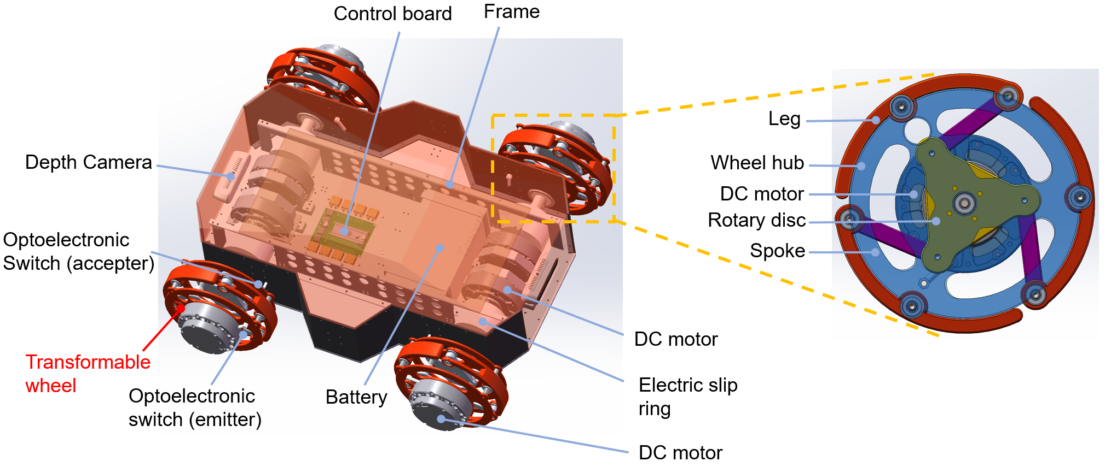
Configuration of the robot platform
Design of the Transformable Wheeled Robot Platform
Notes:
This is the configuration of the robot platform. It includes eight identical brushless DC motors, four motors for the wheel transformation, and the other four motors for robot driving.

Slide 12
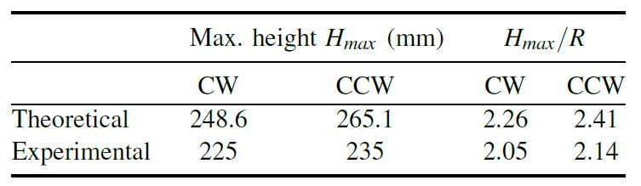

Evaluation of the obstacle-overcoming ability of the early-stage prototype
Experiment
An early-stage prototype of Trimode is made quickly by 3D-printing
Theoretical & experimental maximum height of step that Trimode successfully climbs:
Success rate when climbing steps in legged wheel modes:
Successful climb
Notes:
(click video) We first manufacture a prototype quickly by 3D-printing to validate its step-climbing ability in both legged wheel modes. In CW and CCW legged wheel modes, the robot transforms from the circular wheel in front of the step and hokes the step with the end of the legs.
(click) After gradually increasing height of the step, we get the maximum height of the step that the robot can successfully climb. And the robot can still climb steps with a height of more than twice the wheel radii.

Slide 13
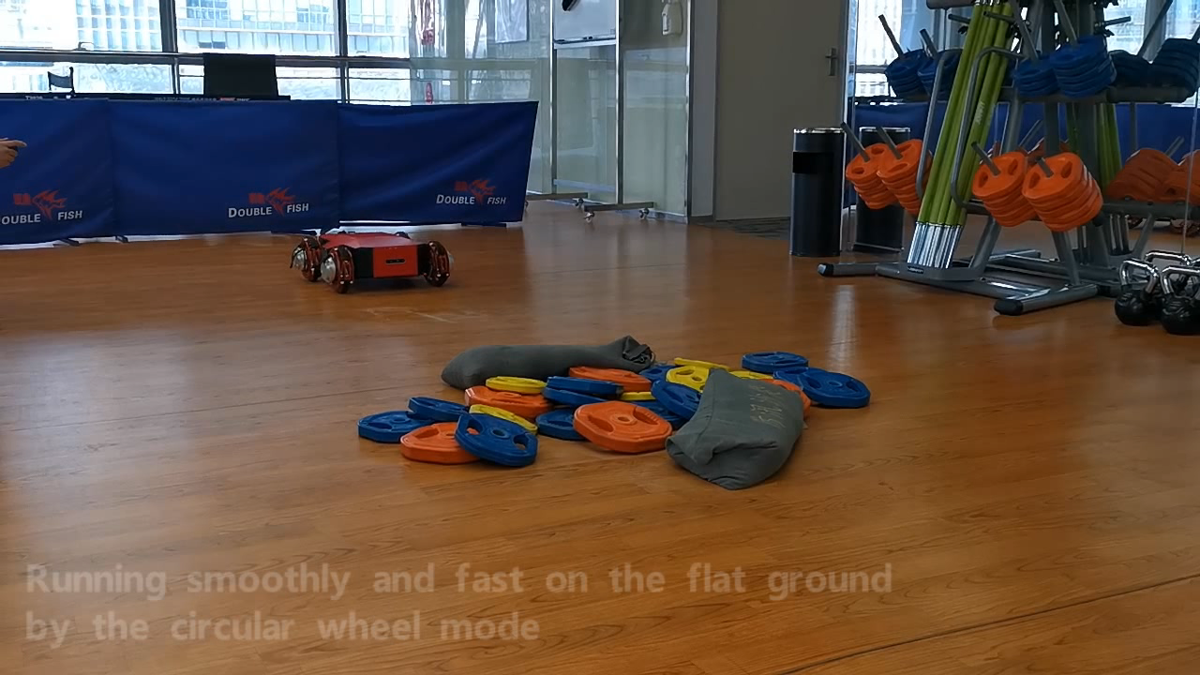
Obstacle-overcoming experiment of the final prototype
Experiment
Notes:
After that, we manufacture a new robot platform with the improvement of the structure, hardware, and appearance.
(click video) In order to prove the future potential in SAR and indoor service tasks, we conduct experiments including traversing uneven terrain and climbing over multiple steps.
We can see that the robot successfully passes through the flat ground, dumbbell pile, and two steps of 120mm high by switching locomotion modes between the circular wheel and CW legged wheel modes.

Slide 14
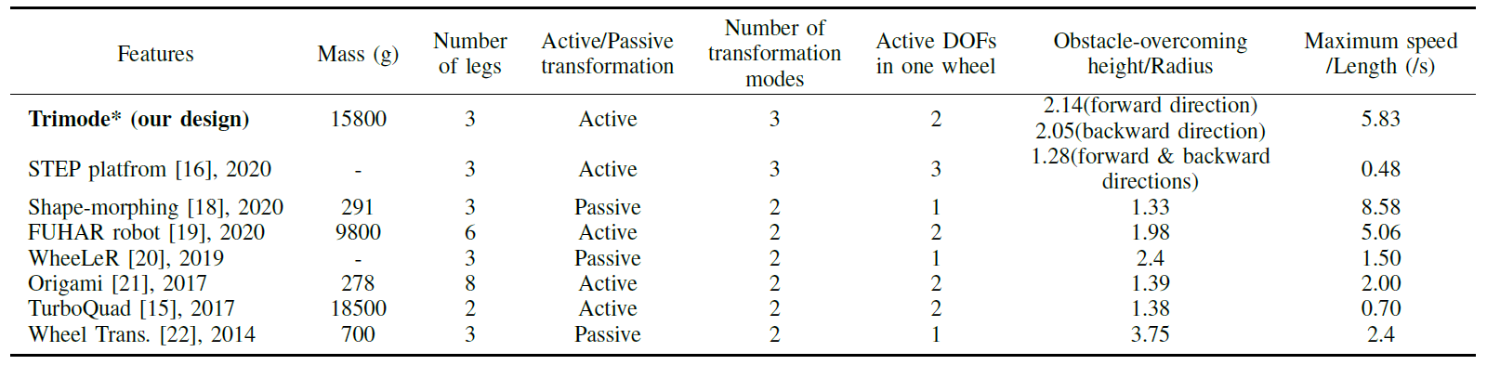
Discussion
Experiment
Comparison of typical hybrid transformable wheel-legged robot
Notes:
Let’s compare our robot with several typical hybrid transformable wheel-legged robots. The second line of the table is our robot Trimode.
(click) Only the proposed Trimode and STEP have three transformation modes.
(click) But Trimode has the better obstacle-overcoming ability and faster speed.

Slide 15
Conclusions
Concept design
Four-bar mechanism design
Parameters design regarding obstacle-overcoming ability
Robot platform design
Dynamics analysis
Performance parameters
Trimode
A bi-directional transformable wheel robot
EXPERIMENT
An early-stage prototype made by 3D-printing
Obstacle-overcoming experiment
Notes:
In this presentation, we propose a bi-directional transformable wheel robot called Trimode. Based on a four-bar mechanism, we establish mathematical models to design parameters of the wheel, and establish dynamic models to choose parameters of the robot platform. We validate performance of Trimode through two prototypes. Results show that Trimode can overcome steps with a height of more than twice the wheel radii and work well in uneven terrain.

Slide 16
Thanks for your attention!
Speaker: Hao Xu
E-mail: wzguo@sjtu.edu.cn / xavierqwxu@tencent.com
Notes:
That’s all of my presentation, thanks for your listening!

